Slide 1
MALIGNANT COMMENTS CLASSIFICATION
Submitted by-
Ashu Chaudhary

Slide 2
Problem Statement Analysis
Social media platforms are the most prominent grounds for toxic behaviour.
There has been a remarkable increase in the cases of cyberbullying and trolls on various social media platforms.
Although researchers have found that hate is a problem across multiple platforms, there is a lack of models for online hate detection.
Our goal is to build a prototype of online hate and abuse comment classifier which can used to classify hate and offensive comments so that it can be controlled and restricted from spreading hatred and cyberbullying.

Slide 3
Data set description
The data set contains the training set, which has approximately 1,59,000 samples and the test set which contains nearly 1,53,000 samples. All the data samples contain 8 fields which includes ‘Id’, ‘Comments’, ‘Malignant’, ‘Highly malignant’, ‘Rude’, ‘Threat’, ‘Abuse’ and ‘Loathe’.
The label can be either 0 or 1, where 0 denotes a NO while 1 denotes a YES. There are various comments which have multiple labels.
The first attribute is a unique ID associated with each comment.

Slide 4
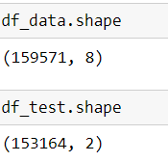
Exploratory data analysis process
Using the shape we find out the total number of rows & columns present in the dataset.

Slide 5
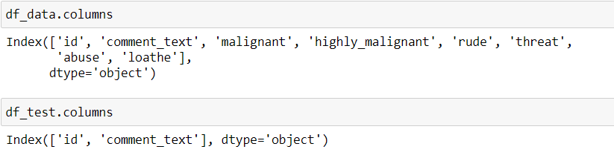
Exploratory data analysis process
By using columns function we find out name of each columns available in both training & testing dataset.

Slide 6
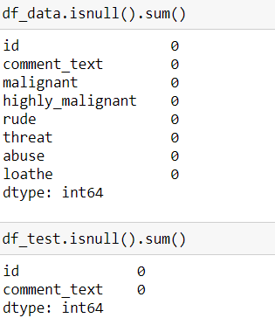
Exploratory data analysis process
From this function we find out the number of null values available in each columns that is the number of missing values available in each column both in train & test dataset.

Slide 7
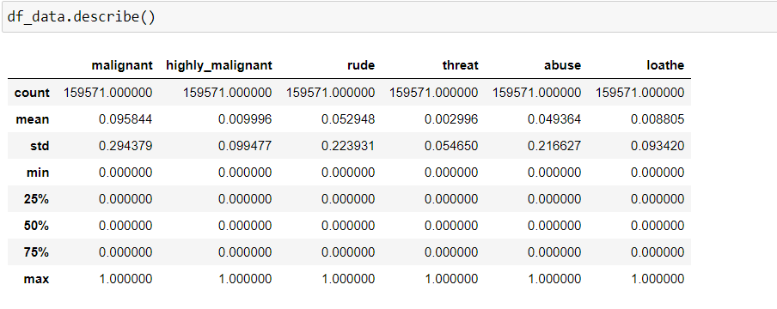
Exploratory data analysis process
From the describe method we got to know the five point summary analysis for a continuous variable.

Slide 8
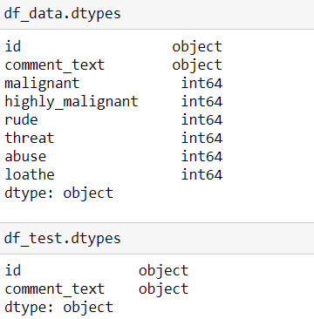
Exploratory data analysis process
By using “dtypes” we got to know the data types for each of the columns. Mostly data type are int64 in nature for training dataset and for test data type are classified under object type.

Slide 9
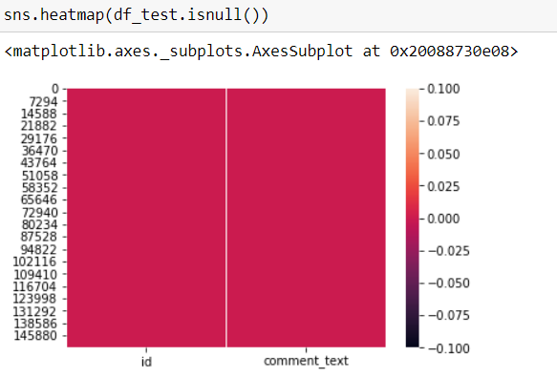
Data Visualization process
From the above visualizations using heatmap we are trying to find out if there is any null value present in the testing dataset of the project. As clearly shown using the heatmap there is no null value present in the test dataset.

Slide 10
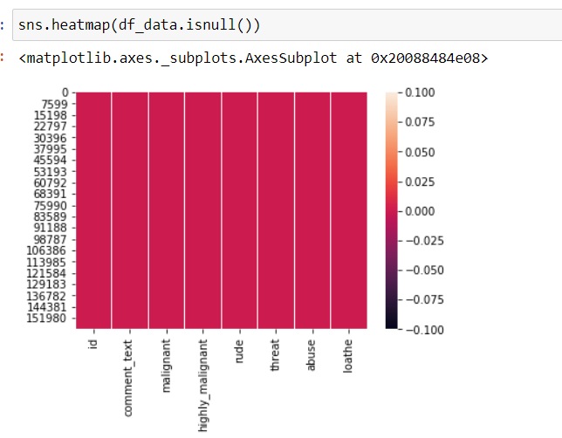
Data Visualization process
From the above visualizations using heatmap we are trying to find out if there is any null value present in the training dataset of the project. As clearly shown using the heatmap there is no null value present in the training dataset.

Slide 11
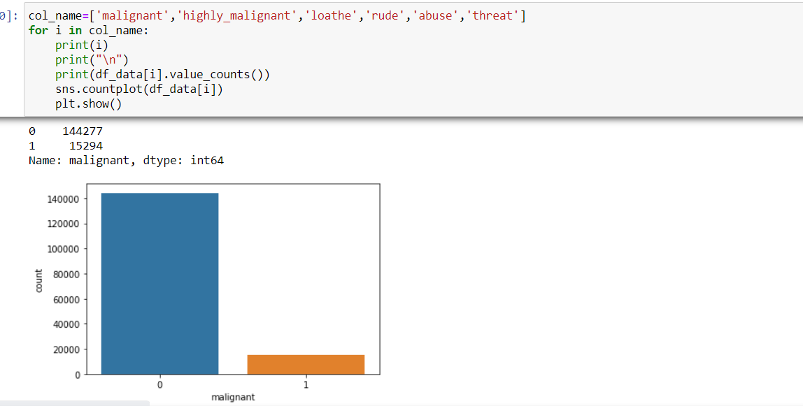
Data Visualization process
From the above count plot, we are trying to find out the malignant comments in the dataset.

Slide 12
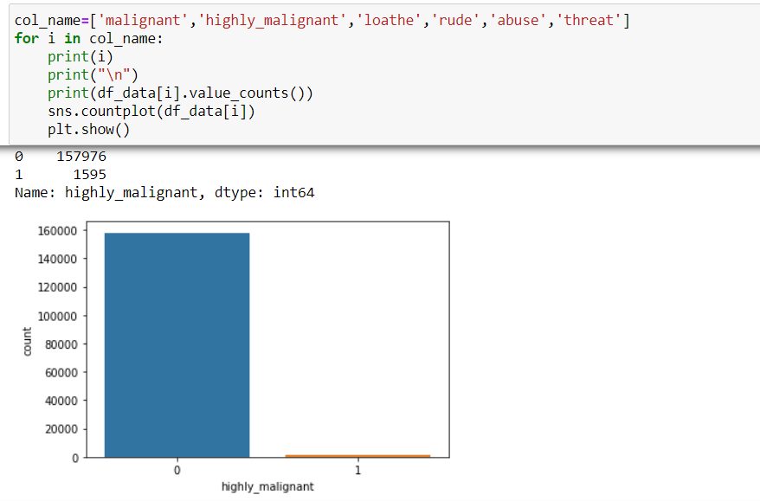
Data Visualization process
From the above graph we are getting the highly malignant count in the training dataset using the count plot under seaborn library.

Slide 13
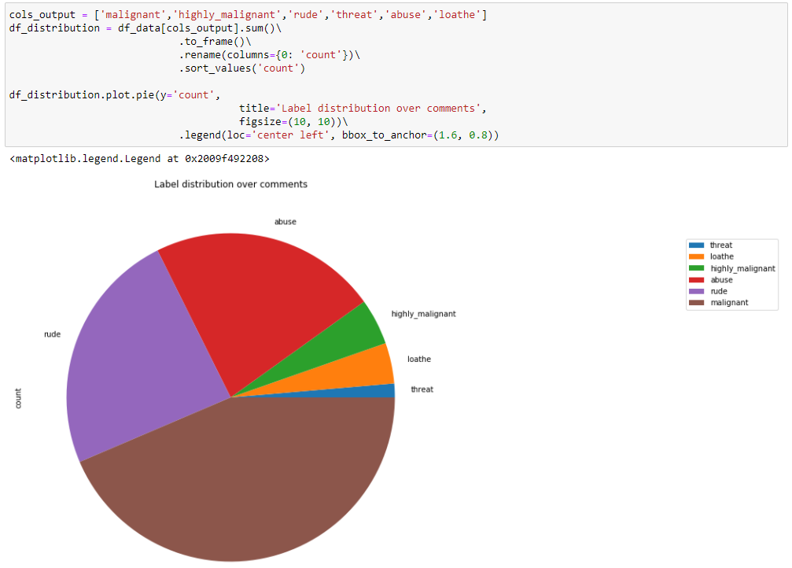
Data Visualization process
From the above distribution plot, we have found out how the input parameters like ‘malignant’, ‘highly_malignant’, ‘rude’, ‘threat’, ‘abuse’, ‘loathe’ are distributed across the dataset using a pie chart.

Slide 14
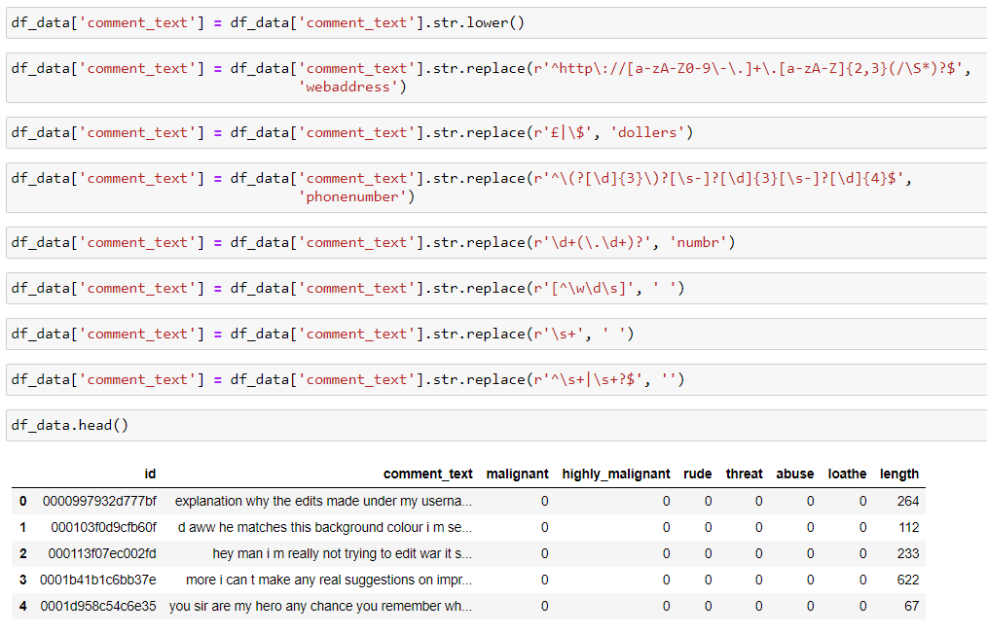
Data preprocessing stage
In this pre-processing process I have mainly cleansed the data using NLTK library and prepared the right set of data for further processing & for classifying the model.

Slide 15
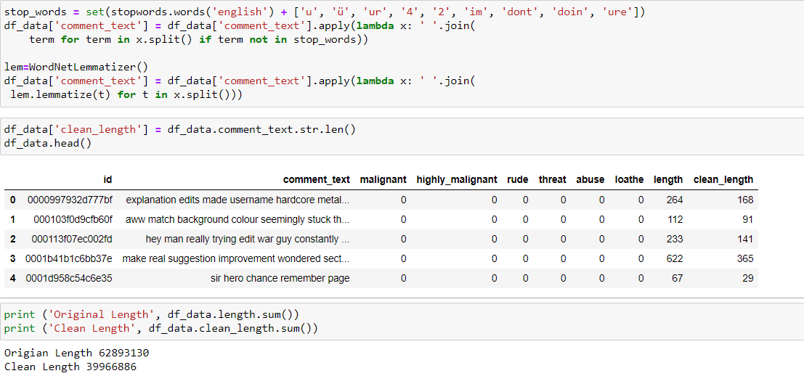
Data preprocessing stage
We have removed the stop words from the dataset and used wordnet lemmatizer to split the comments and find the structured semantic relationship between words and clean the text data/comments for further processing.

Slide 16
Model building process
In this dataset, I classified “bad” as the target variable which is a binary classification data, hence we have used various classification method for Machine learning model building process.
I have come across some features for malignant/highly malignant comments which handled as per the my understanding.
Proposed a random forest classifier model to predict the best accuracy score , also used cross validation to find the trade off between bias-variance.

Slide 17
Model Dashboard
ML Algorithm Used | Predicted Score
Random Forest Classifier | 95.77%
Decision Tree Classifier | 94.22%
Gradient Boosting Classifier | 94.08%
Ada Boosting Classifier | 94.59%
Extra Tree Classifier | 95.68%
k neighbors classifier | 91.60%
Xgboost Classifier | 95.46%
Logistic Regression | 95.62%
To predict the result of this dataset above are classification models used for evaluations.
Out of all the machine learning models used I have selected Random forest classifier model for further evaluation of this dataset.

Slide 18
CONCLUSIONS
I have used various classifications methods and out of all algorithm, random forest classifier yields the best results.
I have also used cross validation technique to find the trade-off between bias& variance
These malignant comments classification can be used by social media companies to filter and classify some keywords as highly malignant and set their own policy going forward for the customers and other shareholders.

